Slide 1
Outline
Repetition structure/Control Loop Statements
  for statement
  while statement
  do-while statement
Jump Statements
  break
  continue
  goto
  return

Slide 2


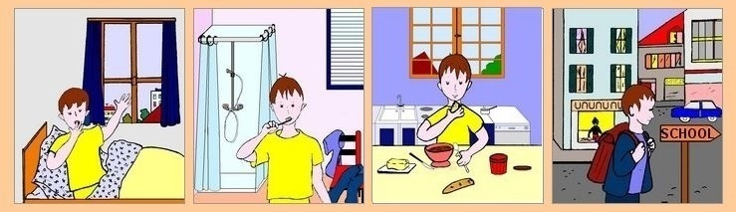
Repetition(Going to School)
Day = Monday to Saturday

Slide 3
Repetition Statement
A repetition statement allows you to specify that an action is to be repeated while some condition remains true.

Slide 4

Looping (repetition)
Quick yak:
Share that if one might have known this earlier: How easy it might have been to undergo the punishment of writing 100 times
“I will not talk in class” in school.
What if we want to display hello 500 times?
  Should we write 500 printf statements or equivalent ?
Obviously not.
It means that we need some programming facility to repeat certain works.
Such facility is available in form of looping statements.

Slide 5
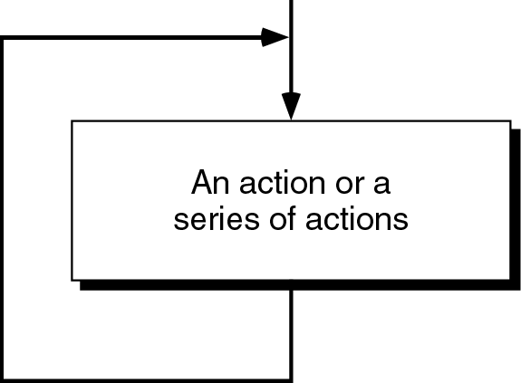
Loop
The main idea of a loop is to repeat an action or a series of actions.
The concept of a loop without condition

Slide 6
But, when to stop looping?
In the following flowchart, the action is executed over and over again. It never stops – This is called an infinite loop
Solution – put a condition to tell the loop either continue looping or stop.
Quick yak:
Condition specific eject can enumerated as:
Stop walking if destination is reached
Start rinsing after said repetition of brush movements

Slide 7
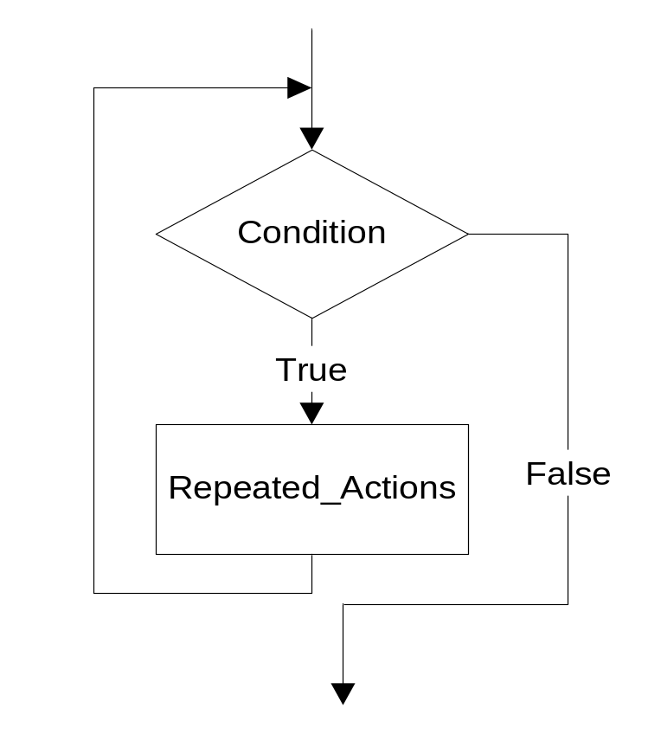
Loop
A loop has two parts – body and condition
Body – a statement or a block of statements that will be repeated.
Condition – is used to control the iteration – either to continue or stop iterating.

Slide 8
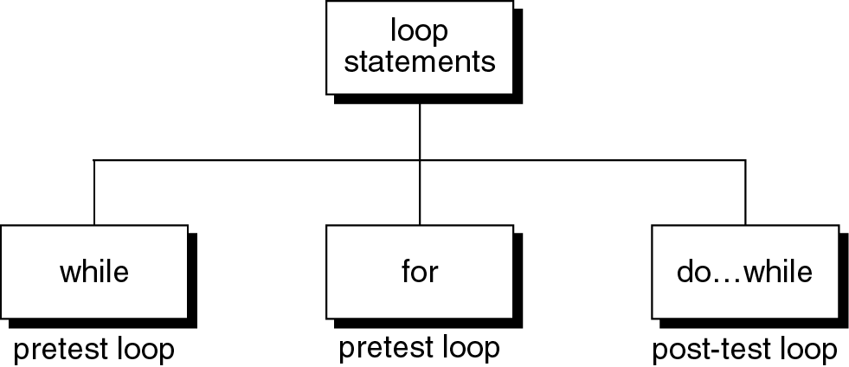
Loop statements
C provides three loop statements:

Slide 9
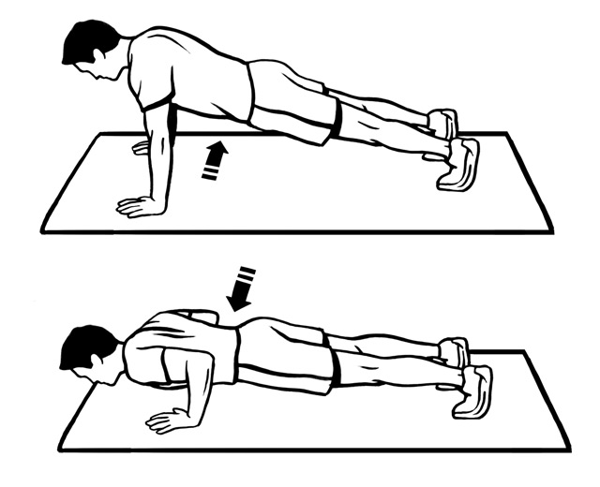
The “while” Statement in C
The syntax of while statement in C:
while (loop repetition condition){
statement;
updating control;
}
Syntax
While fatigue level is not reached

Slide 10
while statement
while(loop repetition condition)
{
Statements;
}
Loop repetition condition is the condition which controls the loop.
The statement is repeated as long as the loop repetition condition is true.
A loop is called an infinite loop if the loop repetition condition is always true.

Slide 11
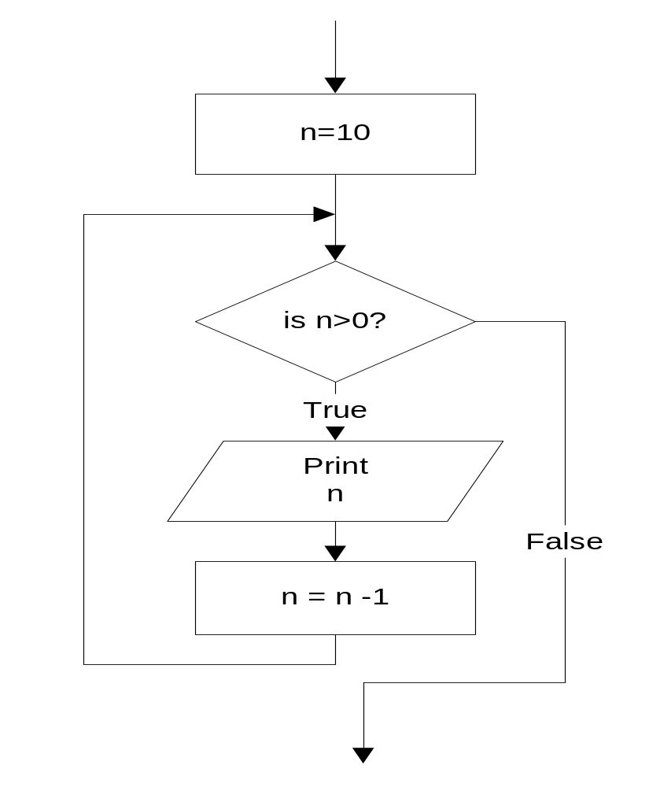
while statement
#include<stdio.h>
int main()
{
int n=10;
while (n>0){
printf(“%d ”, n);
n=n-1;
}
}
Quick yak:
To repeat the car game when game has ended i.e. life is equal to zero . That is while the choice is not equal to ‘n’o.
Example: This while statement prints numbers 10 down to 1
10 9 8 7 6 5 4 3 2 1
Do TEN push ups imposes a count condition

Slide 12
The for Statement in C
The syntax of for statement in C:
The initialization-expression set the initial value of the loop control variable.
The loop-repetition-condition test the value of the loop control variable.
The update-expression update the loop control variable.
for (initialization-expression;
loop-repetition-condition;
update-expression){
statement;
}
Syntax

Slide 13
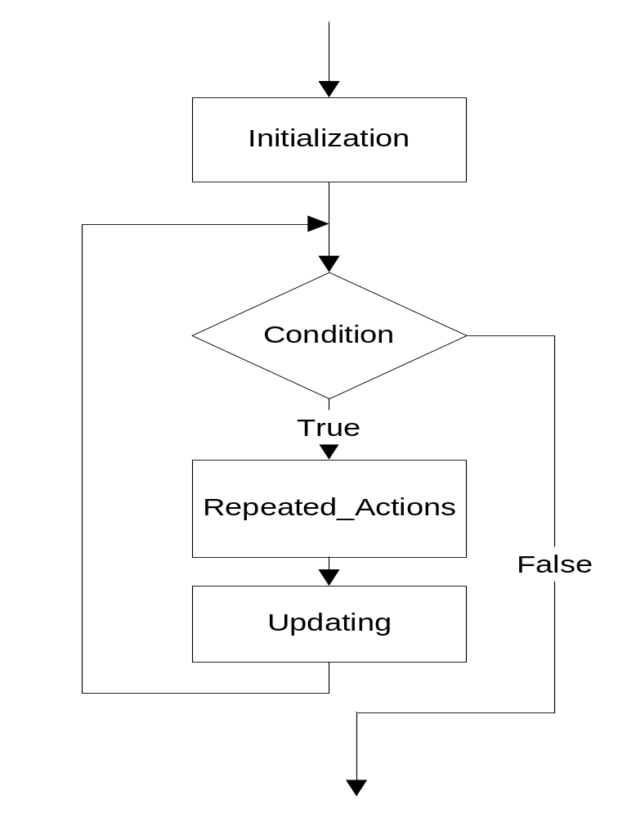
for statement
for (Initialization; Condition; Updating)
{
Repeated_Actions;
}
Quick yak:
For loop to repeat the car game from life = 5 to life > 0.

Slide 14
for statement
Example: This for statement prints numbers 10 down to 1
#include<stdio.h>
int main()
{
int n;
for (n=10; n>0; n=n-1){
printf(“%d ”, n);
}
}
10 9 8 7 6 5 4 3 2 1
Do TEN push ups = for count=1; count<=10; count++

Slide 15
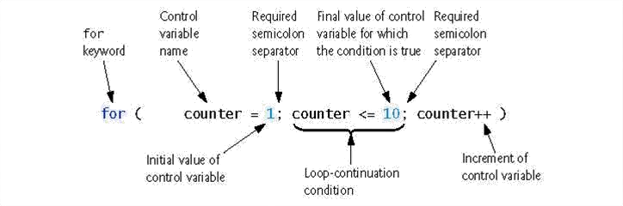

Slide 16
Nested Loops
Nested loops consist of an outer loop with one or more inner loops.
  Eg:
for (i=1;i<=100;i++){
for(j=1;j<=50;j++){
…
}
}
The above loop will run for 100*50 iterations.
Outer loop
Inner loop

Slide 17
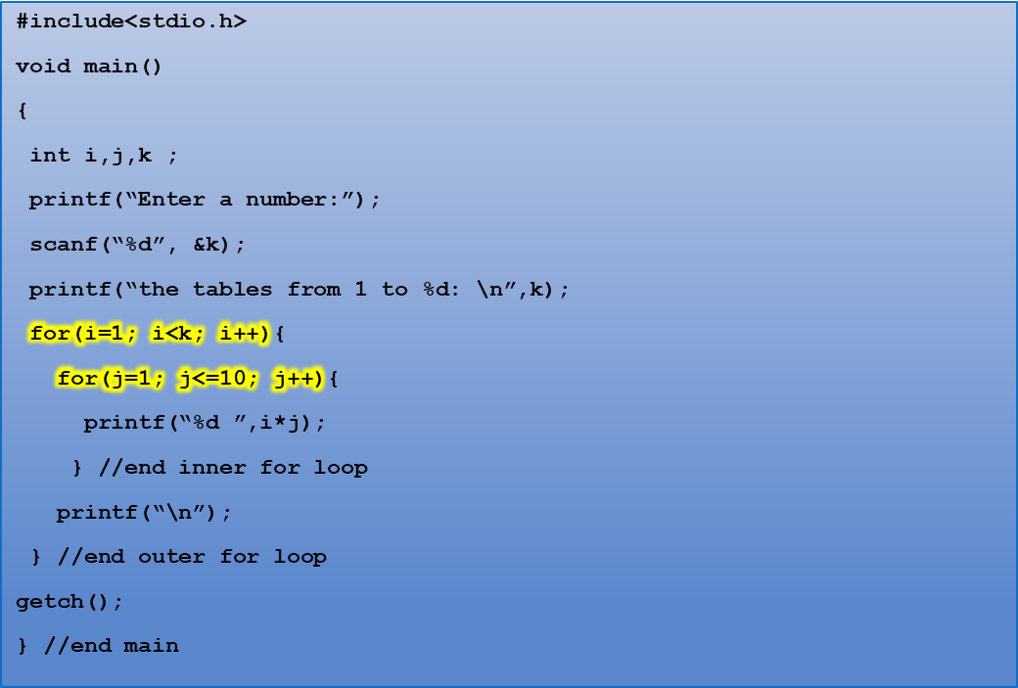
Program to print tables up to a given number.
Quick yak:
Another example would be to display prime numbers upto any given number
Enter a number
4
The tables from 1 to 4
1 2 3 4 5 6 7 8 9 10
2 4 6 8 10 12 14 16 18 20
3 6 9 12 15 18 21 24 27 30
4 8 12 16 20 24 28 32 36 40
Notes:
K =100
Number: 1 cube: 1
Number:2 cube: 8
Number: 3 cube: 27
Number: 4 cube: 64

Slide 18
Program to display a pattern.
#include<stdio.h>
#include<conio.h>
void main()
{
int i,j;
printf(“Displaying right angled triangle for 5 rows”);
for(i=1 ; i<=5 ; i++) {
for(j=1 ; j<=i ; j++)
printf(“* ”);
printf(“\n”);
}
}
Quick yak:
Tell them to display various patterns, ex: reverse right angle triangle, isometric triangle etc.
Displaying right angled triangle for 5 rows
*
* *
* * *
* * * *
* * * * *

Slide 19
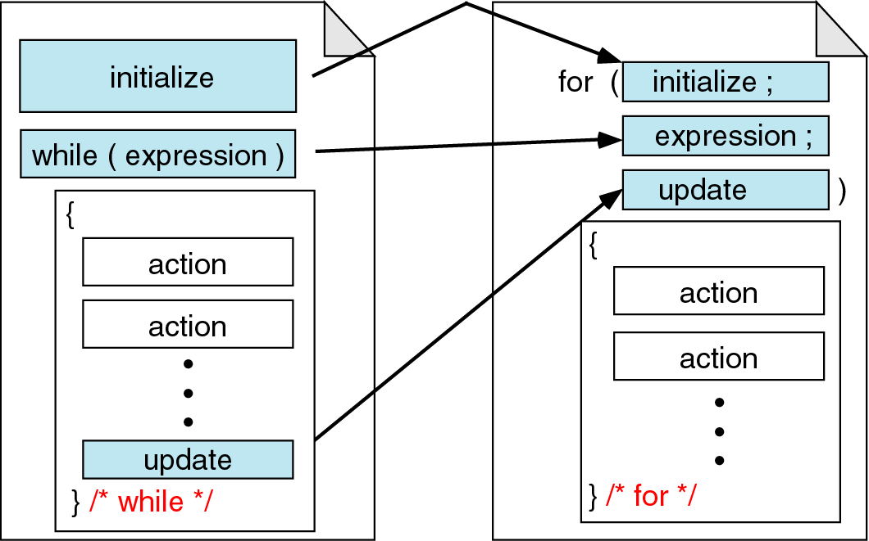
While vs. for statements
Quick yak:
Daily life ex:
While: (date<=last day of class)
{Attend class;
}
For: (rad=1;rad<=10; rad++)
Circle(x,y,rad)
Will make 10 concentric circles
Comparing for and while loops

Slide 20
The do-while Statement in C
The syntax of do-while statement in C:
The statement executed at least one time.
For second time, If the condition is true, then the statement is repeated else the loop is exited.
do
{
statement;
} while (condition);
Syntax
5-<number>

Slide 21
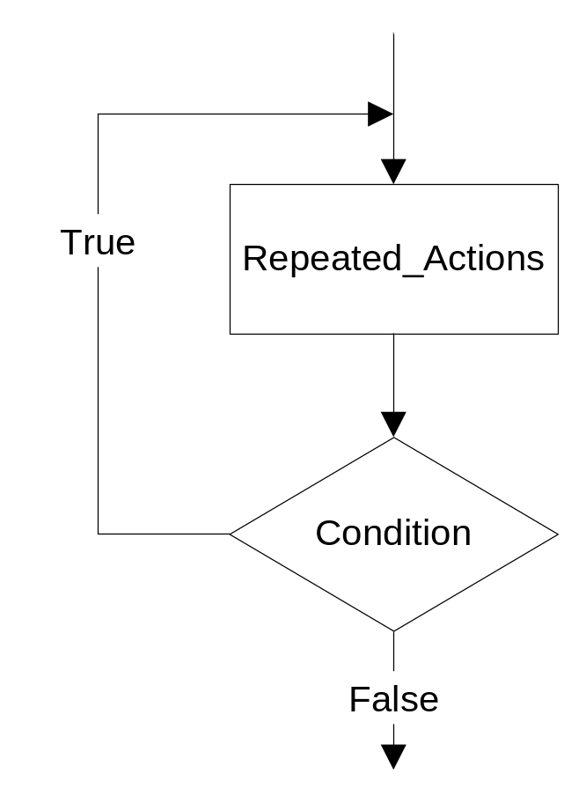
do…while statement
do
{
Repeated_Actions;
} while (Condition);

Slide 22
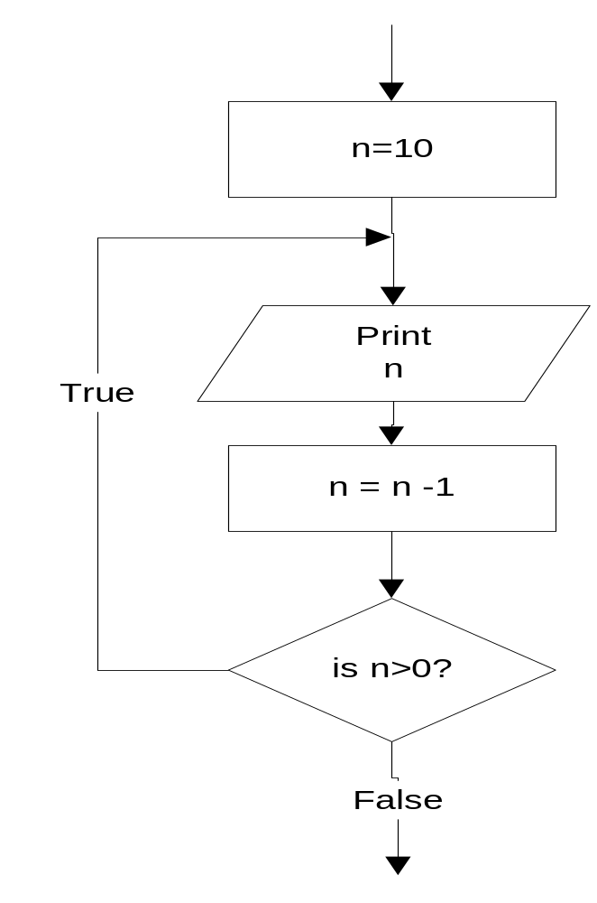
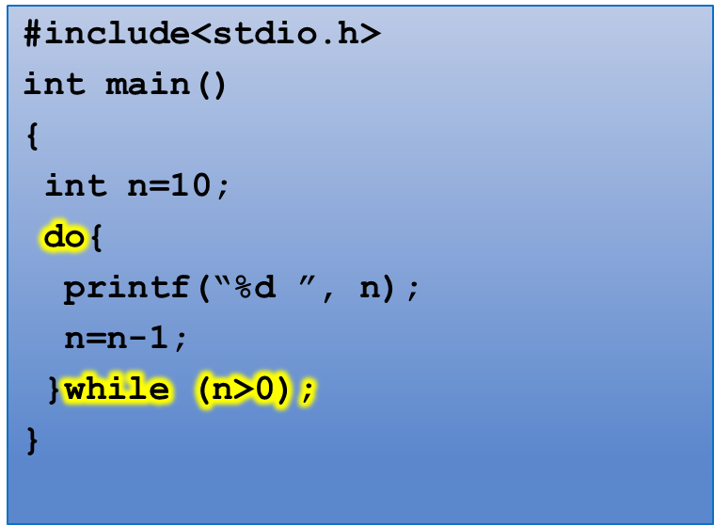
do…while statement
Example: this do…while statement prints numbers 10 down to 1
10 9 8 7 6 5 4 3 2 1

Slide 23
Difference between while and do..while
Quick yak:
The difference is like
Ask age before VOTING: Allow/Disallow
Ask age after VOTING: Reject/accept
while loop | do..while loop
1. Condition is specified at the top | 1. Condition is mentioned at the bottom
2. Body statements are executed when the condition is satisfied | 2. Body statements are executed at least once even if the expression value evaluates to false
3. It is an entry controlled loop | 3. It is an exit controlled loop
4.Syntax: while (condition) statement; | 4.Syntax: do { statements; } while (condition);

Slide 24
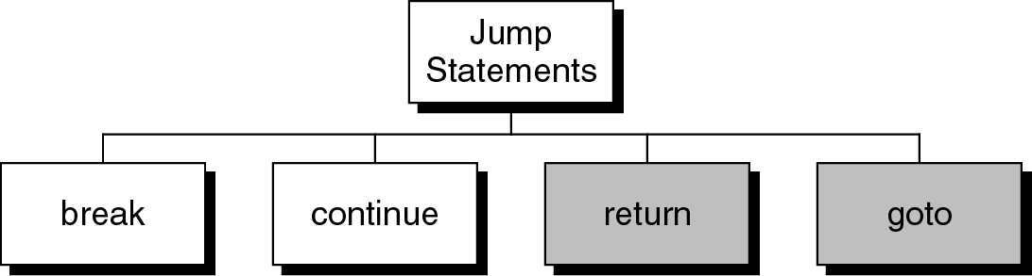
Jump statements
You have learn that, the repetition of a loop is controlled by the loop condition.
C provides another way to control the loop, by using jump statements.
There are four jump statements:

Slide 25
break statement
break is a keyword.
break allows the programmer to terminate the loop.
A break statement causes control to transfer to the first statement after the loop or block.
The break statement can be used in nested loops. If we use break in the innermost loop then the control of the program is terminated only from the innermost loop.

Slide 26
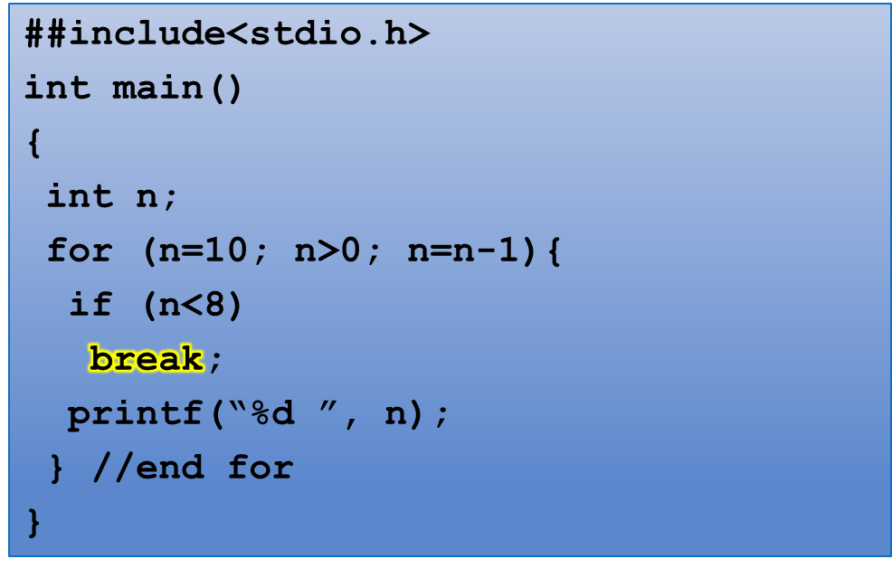
break statement
Program to show use of break statement.
10 9 8

Slide 27
continue statement
continue statement is exactly opposite to break.
continue statement is used for continuing the next iteration of the loop statements
When it occurs in the loop, it does not terminate, but skips the statements after this statement

Slide 28
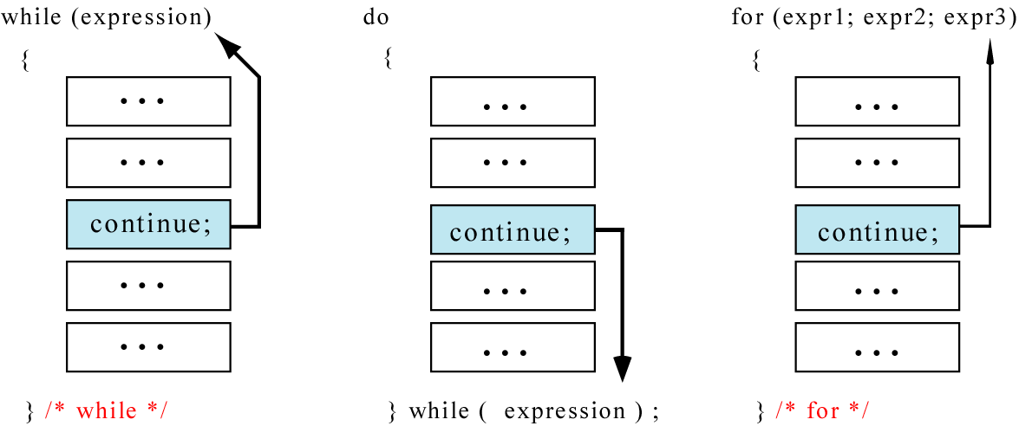
continue statement
In while and do…while loops, the continue statement transfers the control to the loop condition.
In for loop, the continue statement transfers the control to the updating part.

Slide 29
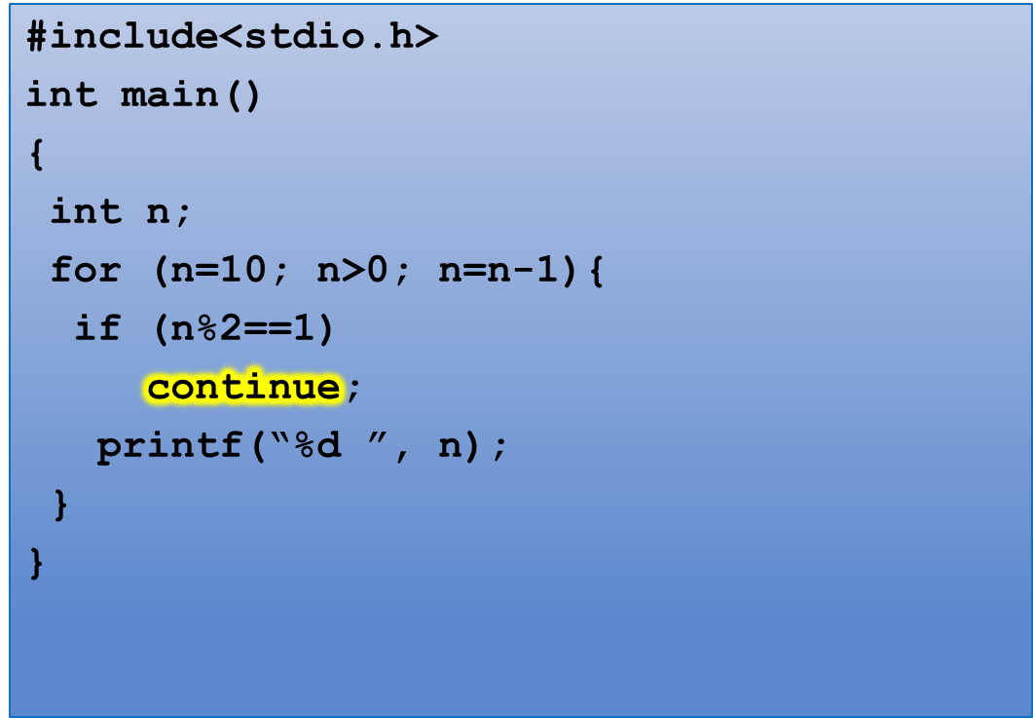
continue statement
Program to show the use of continue statement in for loop
10 8 6 4 2

Slide 30
continue statement
#include<stdio.h>
int main()
{
int n = 10;
while(n>0){
printf(“%d”, n);
if (n%2==1)
continue;
n = n –1;
}
}
Program to show the use of continue statement in for loop
For n=9, loop goes to infinite
execution
The loop then prints number 9 over and over again. It never stops.
10 9 9 9 9 9 …………

Slide 31
goto
Unconditionally transfer control.
goto may be used for transferring control from one place to another.
The syntax is:
goto identifier;
Control is unconditionally transferred to the location of a local label specified by identifier. For example,
Again:
...
goto Again;

Slide 32
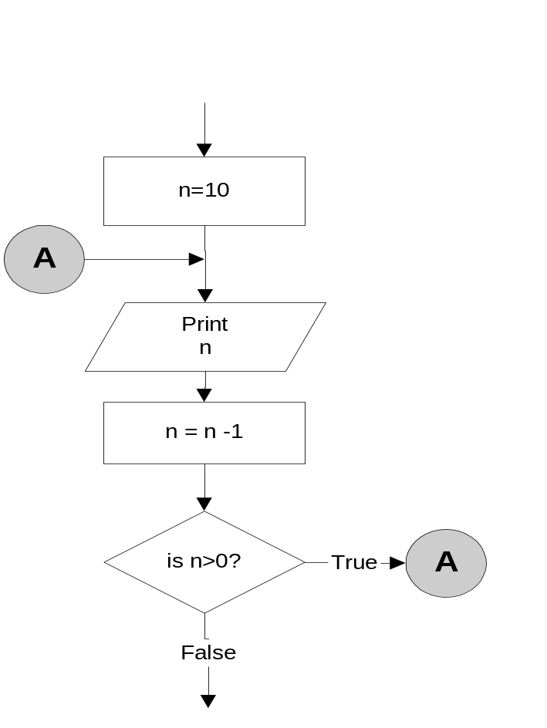
goto statement
n=10;
A:
printf(“%d “, n);
n = n -1;
if (n>0)
goto A;
Output:
10 9 8 7 6 5 4 3 2 1

Slide 33
Program to show goto statement.
#include<stdio.h>
void main()
{
int x;
printf(“enter a number: ”);
scanf(“%d”,&x);
if(x%2==0)
goto even;
else
goto odd;
even:
printf(“ %d is even”, x);
return;
odd:
printf(“%d is odd”, x);
}
enter a number: 18
18 is even

Slide 34
return statement
Quick yak:
Return can be enumerated by example of sugar in tea i.e.
Put more sugar is returned by the function check_sugar()
Exits the function.
return exits immediately from the currently executing function to the calling routine, optionally returning a value. The syntax is:
return [expression];
For example,
int sqr (int x){
return (x*x);
}

